Slide 1

LOVELY PROFESSIONAL UNIVERSITY
INT213 PROJECT
TYPING SPEED TEST GAME
SUBMITTED TO :
SAGAR PANDEY
GROUP MEMBERS :
SUBHASH KUMAR(ROLL - 51)
SUPRIYA KUMARI (ROLL -46)
SECTION - K19HZ
GROUP - 2

Slide 2
CONTENTS
INTRODUCTION
LIBRARIES USED
MODIFICATIONS
REFERENCES
CALCULATION
SCREENSHOTS

Slide 3
INTRODUCTION
TYPING SPEED TEST
basic GUI desktop application
calculates the typing speed of the users
a random word from the list of words is given to the user to type
time limit for the user to type is 1 min
Score increases only when user hits the right word
final output is WPM ,Total Score and Accuracy

Slide 4
PYTHON LIBRARIES
TKINTER and Timeit libraries are used for GUI and calculation of time
Random function is used to fetch the random words
Firstly all libraries and functions are imported
Timer will be started as soon as window starts
Time left will be visible on top right corner as soon as the user hits enter

Slide 5
CALCULATIONS
a list is created to keep all the inputs from user and traverse the list to get the total length of characters
another list is created to keep all the correct inputs and traverse to count the total correct length of characters
WPM = (total length of characters)*60/5*(total time)
Accuracy = correct length of characters*100/total characters
Total Score = correct hit - miss

Slide 6
Calculation of Time and LabelSlider Working
The variable timeleft has nothing to do with the calculation part.
Imported Timeit library for the exact time calculation
timer will be started as soon as the user selects any level.
timer will be stopped when the variable timeleft becomes 0
total time = t1-t0
Initialised variables , count = 0 and sliderwords = '' and text = "name of the Project"
checking the condition that whether count>length of text:
If true --> reset count = 0 and sliderwords = empty string again
If false--> add text[count] in sliderwords
increment count
configure the fontLabel
.after(100,labelslider)
.after(time, function call)---> This will call the function after every 100ms and will continue throughout the program.

Slide 7
MODIFICATIONS
USER CAN SELECT FIRSTLY THE LEVELS IN WHICH THEY WANT TO PRACTICE
Beginner -------------> basic and simple words
Intermediate ---------> tougher than beginner
Advanced ----------> complicated Words
Three different text documents are created for different levels containing words according to the level
icon of window has been changed
word slider has been used
Used Messagebox for asking Retry and Cancel from user

Slide 8
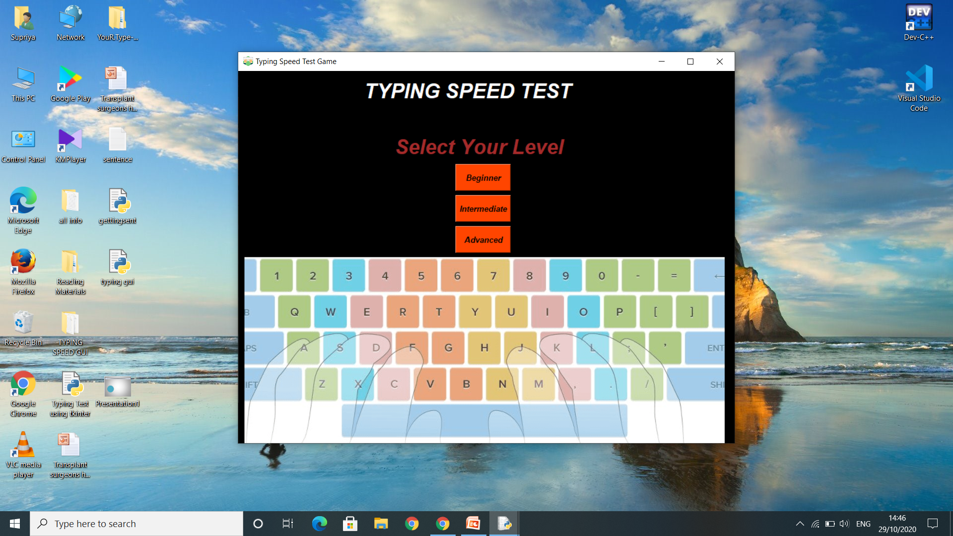
SCREENSHOTS

Slide 9
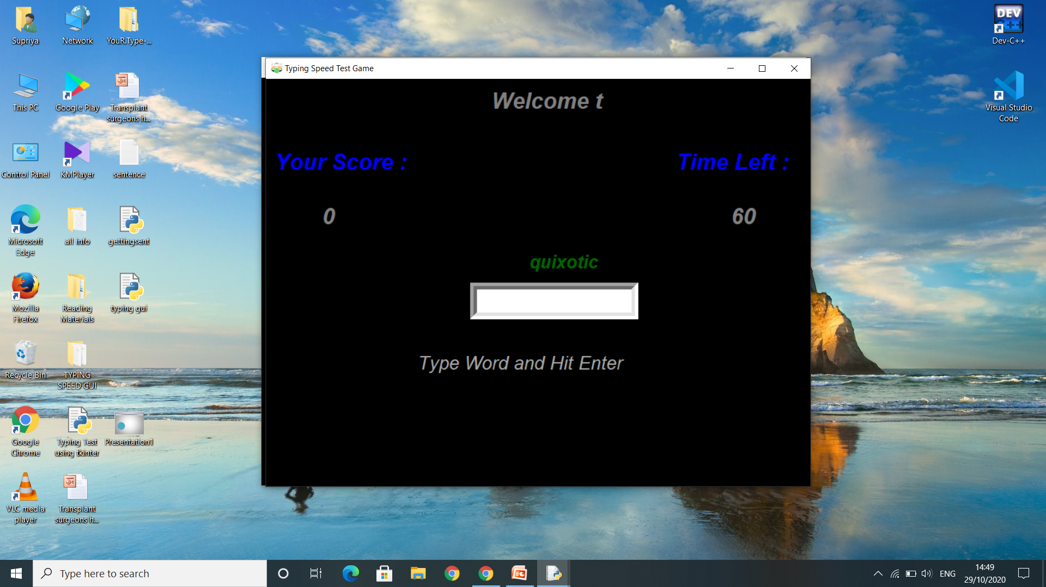

Slide 10
REFERENCES
https://www.geeksforgeeks.org/how-to-test-typing-speed-using-python/
https://www.skyfilabs.com/project-ideas/speed-typing-test-with-python
https://techvidvan.com/tutorials/project-in-python-typing-speed-test/
https://www.datacamp.com/community/news/python-project-on-typing-speed-test-build-your-first-game-in-python-f28no23fbi
https://realpython.com/intermediate-python-project-ideas/

